Slide 1
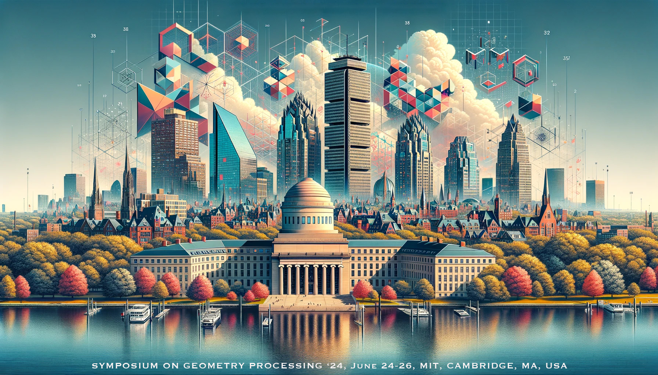
Deep Learning for 3D Geometry
SGP 2024 Graduate School

Slide 2
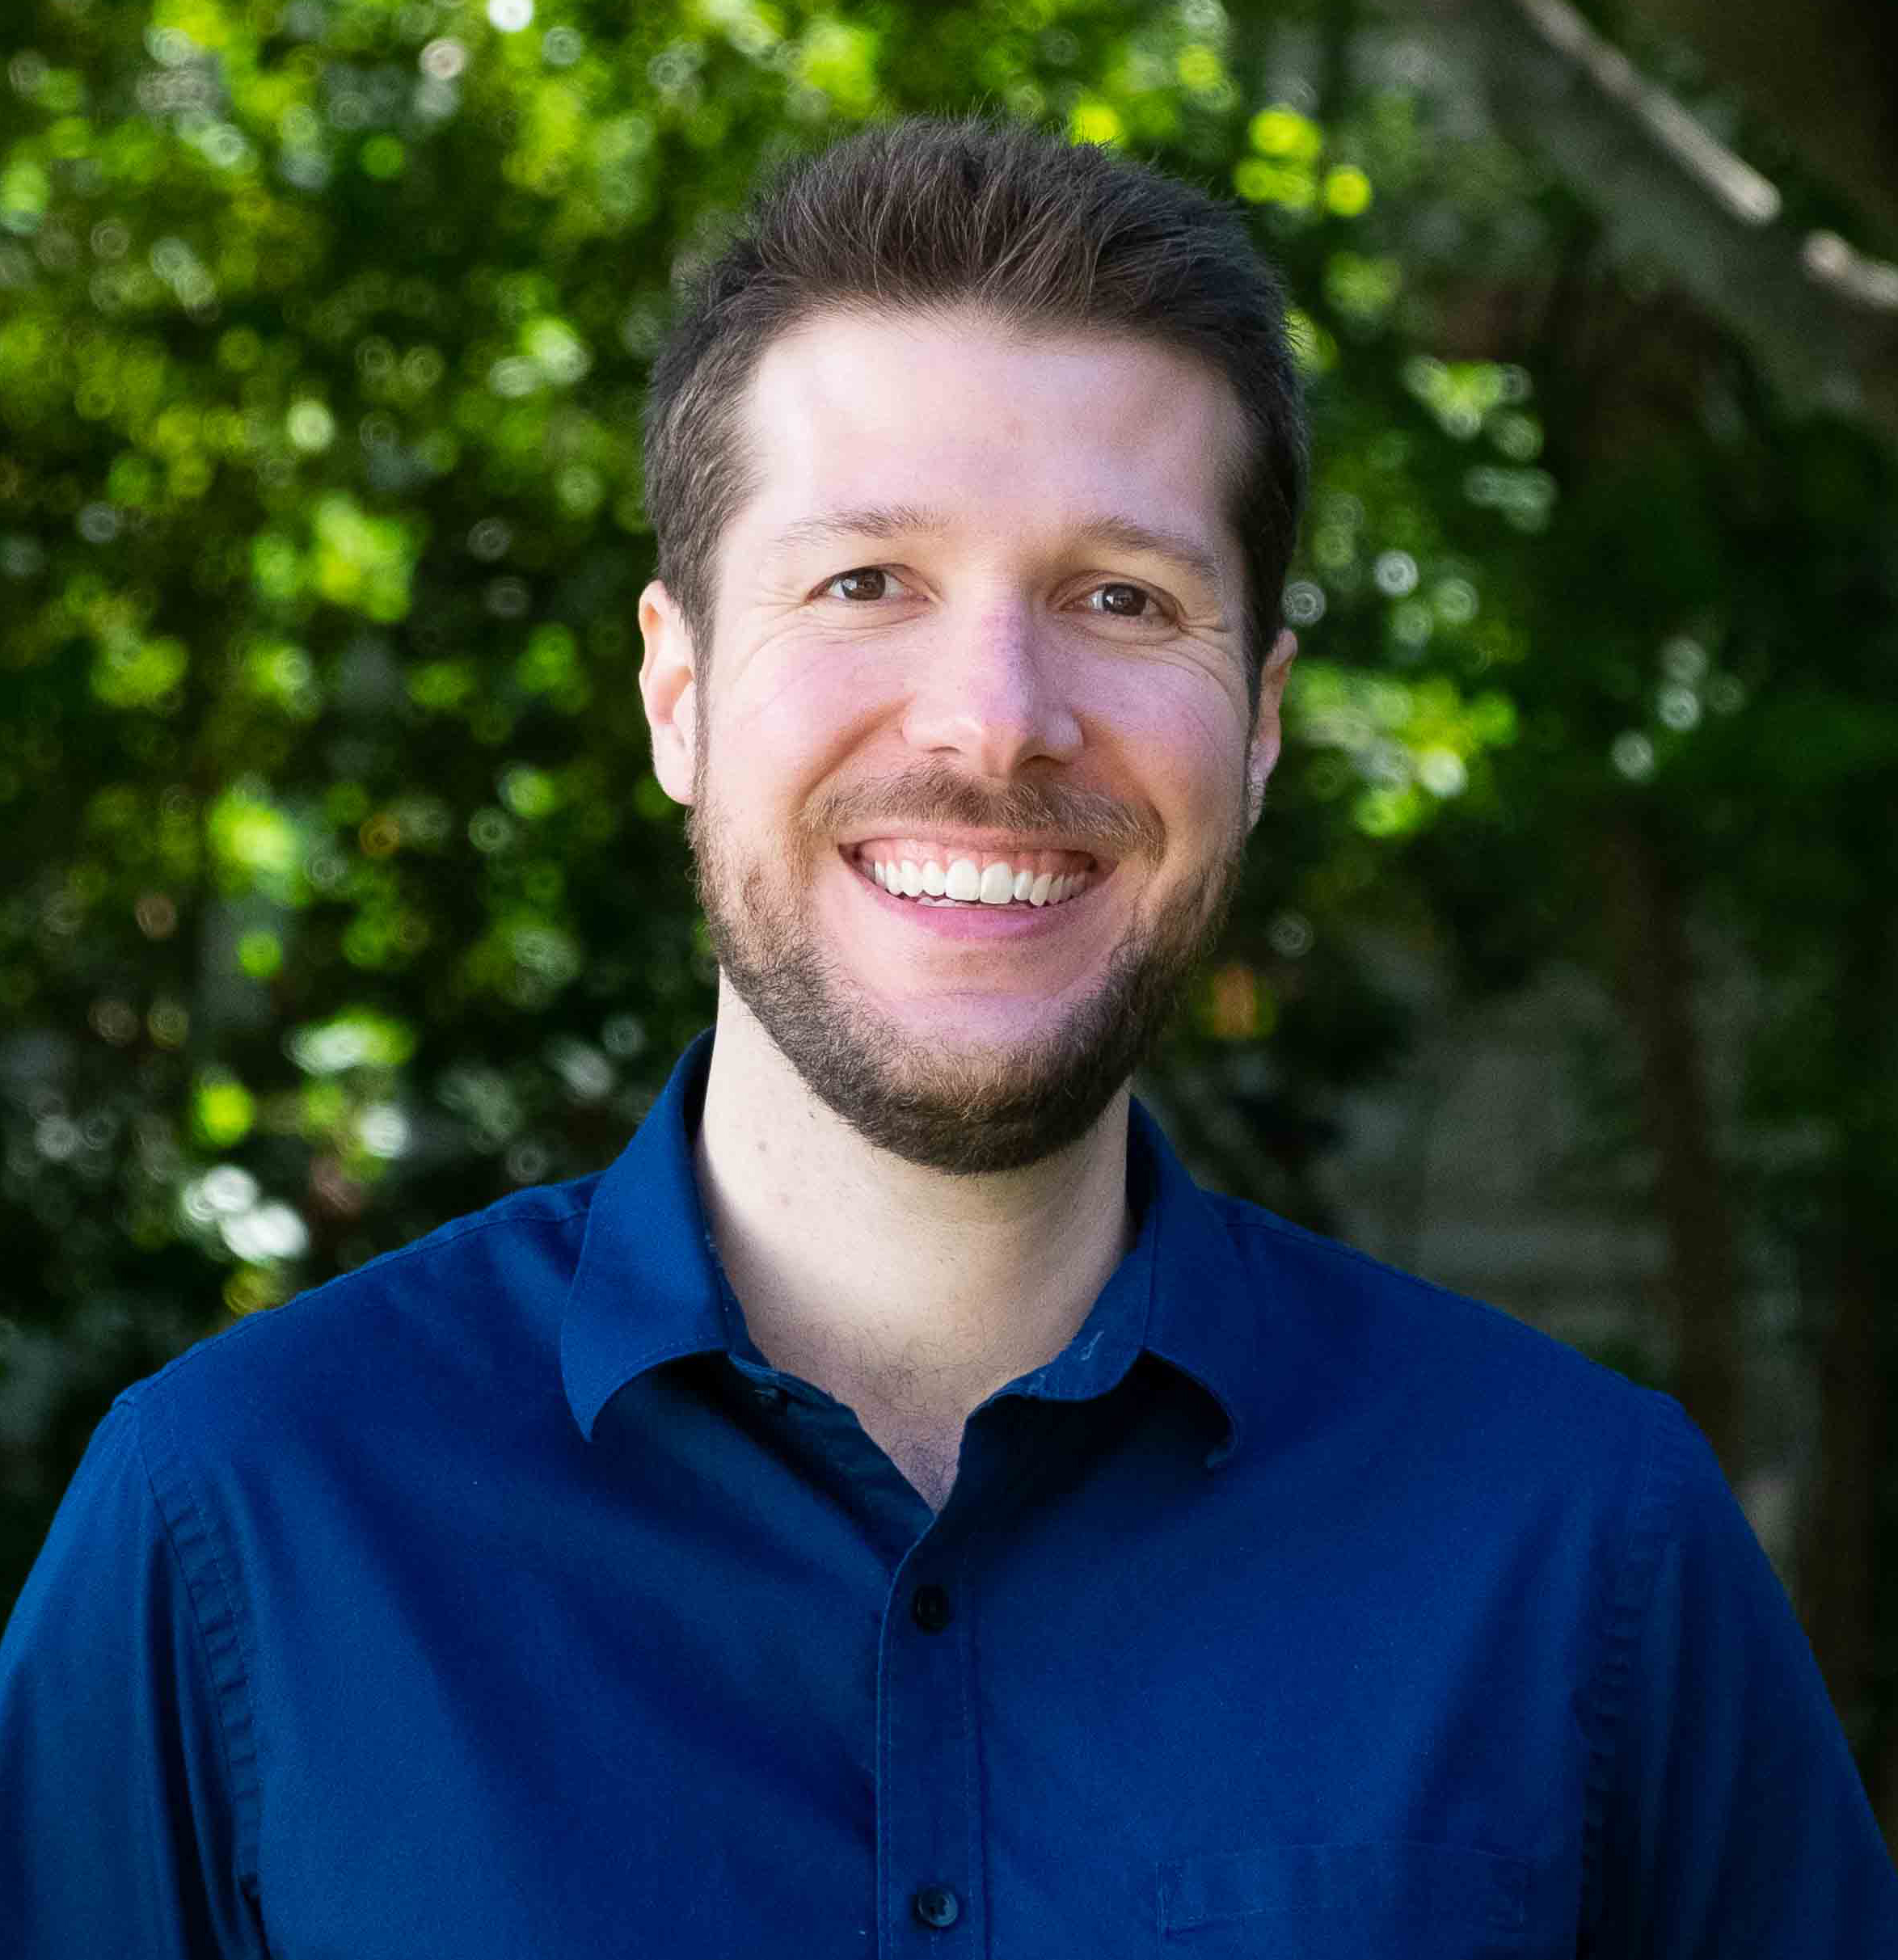
Your Instructors 👨‍🏫👩‍🏫
Daniel Ritchie
Zoë Marschner
Prof @ Brown
Graphics + ML, 3D Shape/Scene Generation, Program Synthesis
My 1st (in person) SGP!
PhD @ CMU
Geometry Processing, Interesting Shape Representations, DDG
My 1st (in person) SGP!

Slide 3
Our Students (i.e. You!)
Raise a hand if:
This is your first SGP
You are a:
Grad student
Undergrad student
You’ve done any geometry processing
You’ve done any deep learning
You’ve done any deep learning for geometry processing

Slide 4
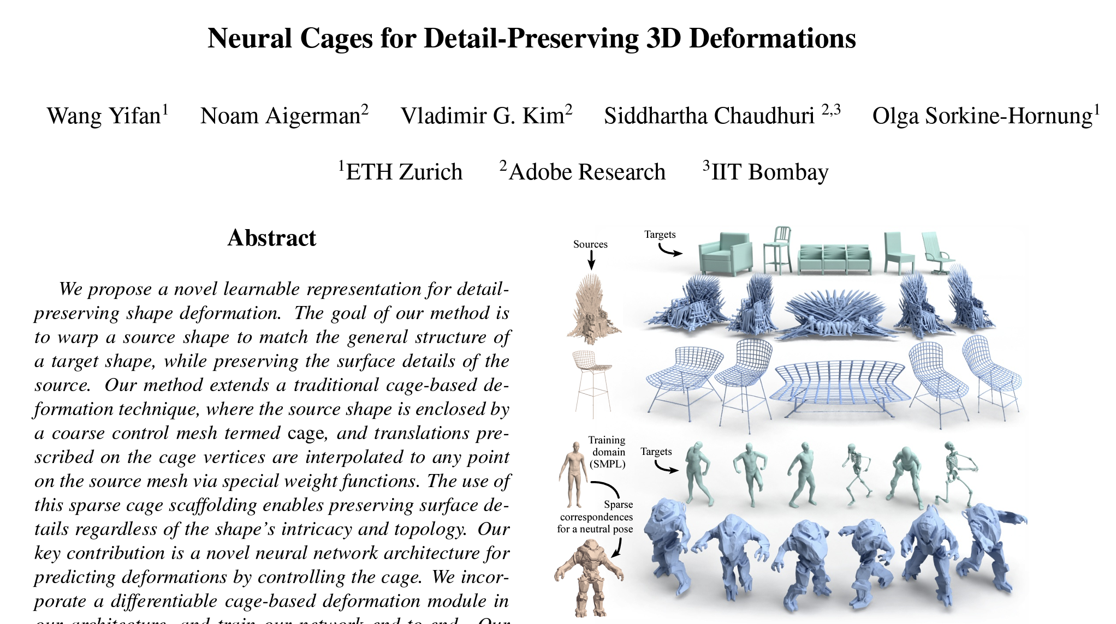
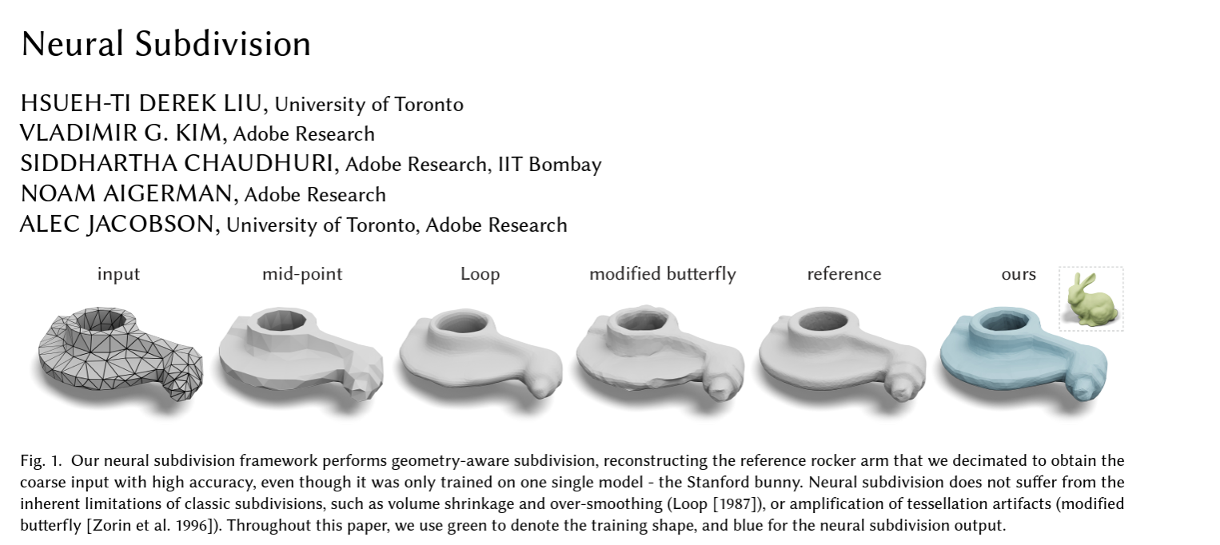
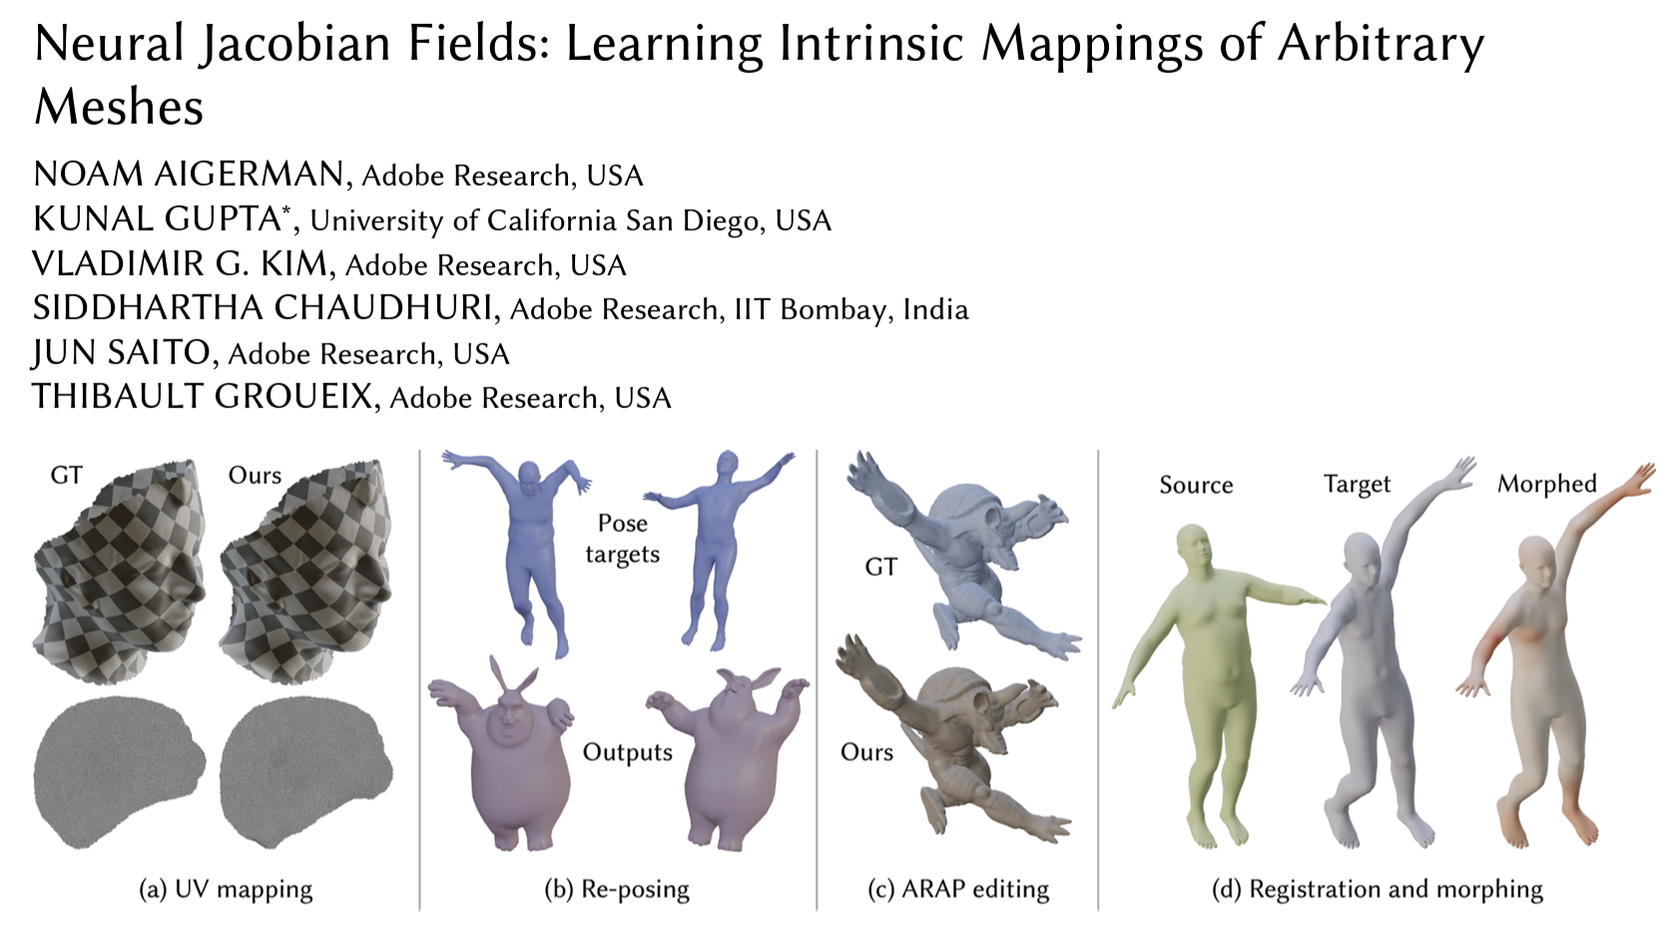
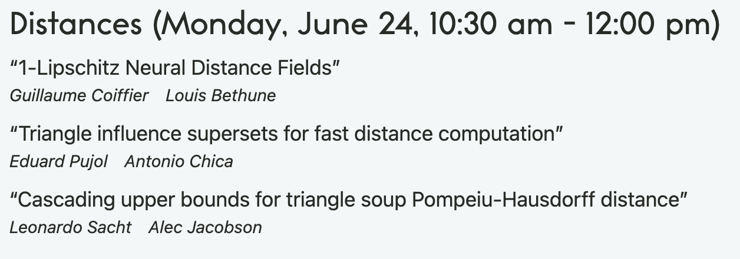
Why This Course?
Deep learning has found its way into the problem-solving toolbox of virtually every field of computer science
Including computer graphics
Including geometry processing ;)
Link
Link
From the SGP ‘24 program
Link

Slide 5
Why This Course?
Deep learning has found its way into the problem-solving toolbox of virtually every field of computer science
Including computer graphics
Including geometry processing ;)
Everyone getting into geometry processing should have a basic understanding of how deep learning is used in the field

Slide 6
Two interpretations of our course title Deep Learning for Geometry Processing
Using neural networks to solve prediction problems involving 3D geometry
Using neural networks as a representation of 3D geometry

Slide 7
Structure of This Course
Two interpretations of our course title Deep Learning for Geometry Processing
Using neural networks to solve prediction problems involving 3D geometry (Daniel, ~40 mins)
Using neural networks as a representation of 3D geometry (Zoë, ~40 mins)
5 minute break

Slide 8
Goals of this Course
You will (hopefully) leave this course:
Knowing the kinds of problems deep learning is being used to solve in geometry processing
Including: having a framework for organizing those problems
Understanding some of the unique challenges in applying deep learning to 3D geometry
Understanding how (and why) to represent 3D shapes with neural networks
Knowing where to look if you want to learn more

Slide 9
Non-Goals of This Course
This course will not
Dive deep into the methodological details of lots of recent papers
Teach (much) about deep learning in general
Teach you how to write PyTorch / Tensorflow / [insert deep learning framework here] programs

Slide 10
Using neural networks to solve prediction problems involving 3D geometry (Daniel, ~40 mins)
Using neural networks as a representation of 3D geometry (Zoë, ~40 mins)
5 minute break

Slide 11
Using neural networks to solve prediction problems involving 3D geometry (Daniel, ~40 mins)
Using neural networks as a representation of 3D geometry (Zoë, ~40 mins)
5 minute break

Slide 12
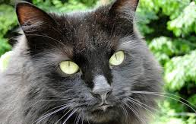
Deep Learning = Function Approximation
Suppose we want to compute $f(x) = y$...
...but $f$ is too complicated for us to write down ourselves
E.g. $f( )$= “cat”
A neural network is a parametric family of functions ${\tilde{f}}_{θ}$ that we can optimize to solve our problem, given a dataset of examples $𝒟$: ${argmin}_{θ}\sum_{\left(x,y\right)∈𝒟}{\left|{\tilde{f}}_{θ}\left(x\right)−y\right|}$

Slide 13
A deep learning problem is characterized by:
What type of prediction problem are we trying to solve?
i.e. what function should ${\tilde{f}}_{θ}\left(x\right)$ compute?
How are we representing the data?
i.e. what form do $x$and $y$ take?
What neural network architecture are we using?
i.e. what parametric family ${\tilde{f}}_{θ}$ are we using?
How will we train the network?
i.e. what optimization algorithm do we use to solve ${argmin}_{θ}\sum_{\left(x,y\right)∈𝒟}{\left|{\tilde{f}}_{θ}\left(x\right)−y\right|}$ ?

Slide 14
A deep learning problem is characterized by:
What type of prediction problem are we trying to solve?
i.e. what function should ${\tilde{f}}_{θ}\left(x\right)$ compute?
How are we representing the data?
i.e. what form do $x$and $y$ take?
What neural network architecture are we using?
i.e. what parametric family ${\tilde{f}}_{θ}$ are we using?
How will we train the network?
i.e. what optimization algorithm do we use to solve ${argmin}_{θ}\sum_{\left(x,y\right)∈𝒟}{\left|{\tilde{f}}_{θ}\left(x\right)−y\right|}$ ?
Not going to cover this today. See e.g. Brown’s Deep Learning course for more

Slide 15
A deep learning problem is characterized by:
What type of prediction problem are we trying to solve?
i.e. what function should ${\tilde{f}}_{θ}\left(x\right)$ compute?
How are we representing the data?
i.e. what form do $x$and $y$ take?
What neural network architecture are we using?
i.e. what parametric family ${\tilde{f}}_{θ}$ are we using?
How will we train the network?
i.e. what optimization algorithm do we use to solve ${argmin}_{θ}\sum_{\left(x,y\right)∈𝒟}{\left|{\tilde{f}}_{θ}\left(x\right)−y\right|}$

Slide 16
A deep learning problem is characterized by:
What type of prediction problem are we trying to solve?
i.e. what function should ${\tilde{f}}_{θ}\left(x\right)$ compute?
How are we representing the data?
i.e. what form do $x$and $y$ take?
What neural network architecture are we using?
i.e. what parametric family ${\tilde{f}}_{θ}$ are we using?
How will we train the network?
i.e. what optimization algorithm do we use to solve ${argmin}_{θ}\sum_{\left(x,y\right)∈𝒟}{\left|{\tilde{f}}_{θ}\left(x\right)−y\right|}$

Slide 17
Types of Prediction Problems in Geometry Processing

Slide 18
A Taxonomy of Prediction Problems
A framework for mentally organizing the kinds of problems learning is used for in geometry processing
"All models are wrong but some are useful” – George Box, 1976
Not every ‘deep learning for geometry’ problem is going to fit perfectly into this framework...
...but sufficiently many do for it to be useful

Slide 19
A Taxonomy of Prediction Problems
Analysis
Synthesis
Compute some property of existing geometry
Generate new geometry
In $f(x) = y$: $x$ is geometry, $y$ is not
In $f(x) = y$: $y$ is geometry,$x$may or may not be

Slide 20
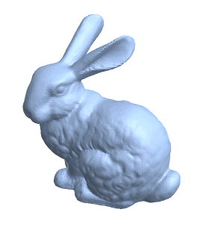
A Taxonomy of Prediction Problems
Analysis
Synthesis
Global
Local
$$y =$$
a single value for the input shape $x$
$$y =$$
a pointwise signal on the input shape $x$
$$f$$
$$f$$
0.5
Source

Slide 21
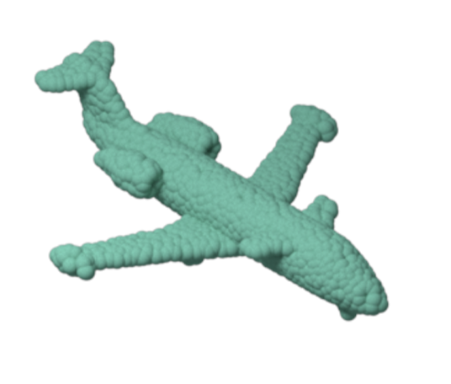
Examples of Global Analysis Problems
Classification
$$x$$
$$y$$
$$f$$
Car
Table
Lamp
Chair
Airplane
Source

Slide 22
Examples of Global Analysis Problems
Classification
Canonicalization
$$x$$
$$f$$
$$f$$
$$f$$
$$f$$
$$y$$
$$(R,t)$$
$$(R,t)$$
$$(R,t)$$
$$(R,t)$$
Source

Slide 23
Examples of Global Analysis Problems
Classification
Canonicalization
Captioning
$$x$$
$$f$$
$$y$$
Source

Slide 24
Examples of Local Analysis Problems
Segmentation
$$x$$
$$y$$
$$f$$
Source

Slide 25
Examples of Local Analysis Problems
Segmentation
Normal estimation
$$x$$
$$y$$
$$f$$
Source

Slide 26
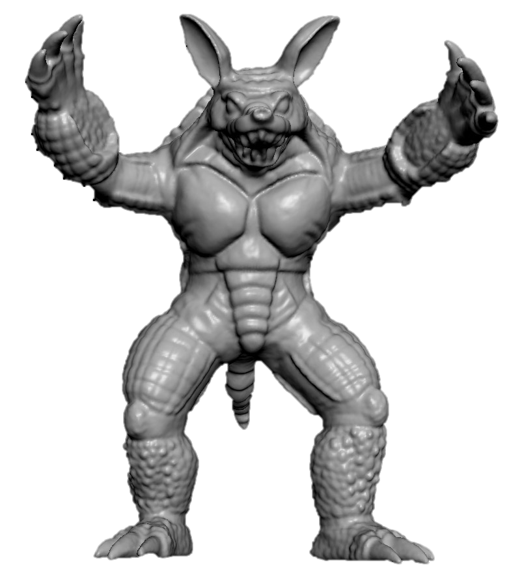
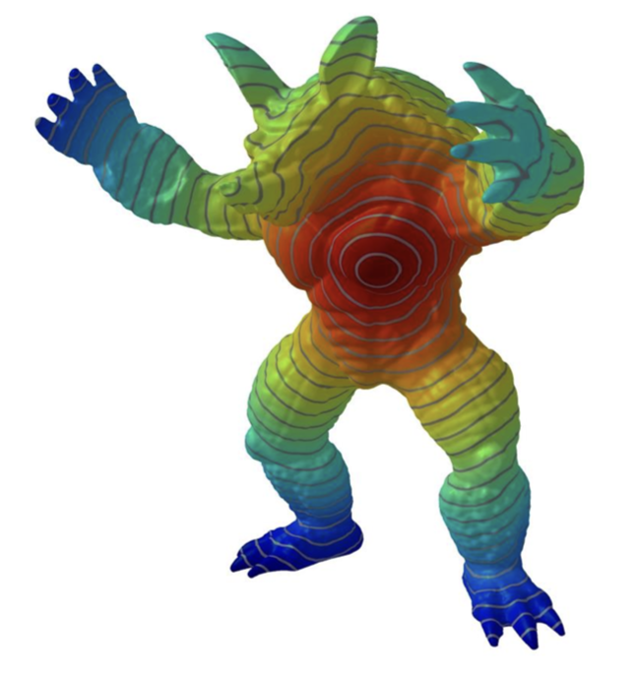
Examples of Local Analysis Problems
Segmentation
Normal estimation
Geodesic distance
$$x=(S,p)$$
$$y$$
$$f$$
Source

Slide 27
Examples of Local Analysis Problems
$$x$$
$$y$$
Segmentation
Normal estimation
Geodesic distance
Shape correspondence
$$f$$
Source

Slide 28
A Taxonomy of Prediction Problems
Analysis
Synthesis
Global
Local

Slide 29
A Taxonomy of Prediction Problems
Analysis
Synthesis
Global
Local
Unconditional
Conditional
$$x =$$
(random numbers, something else)
$x=$random numbers

Slide 30
A Taxonomy of Prediction Problems
Analysis
Synthesis
Global
Local
Unconditional
Conditional
$$x =$$
(random numbers, something else)
$x=$random numbers
Low entropy
High entropy

Slide 31
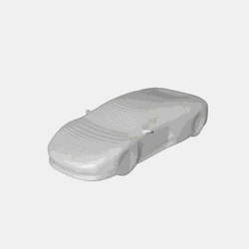
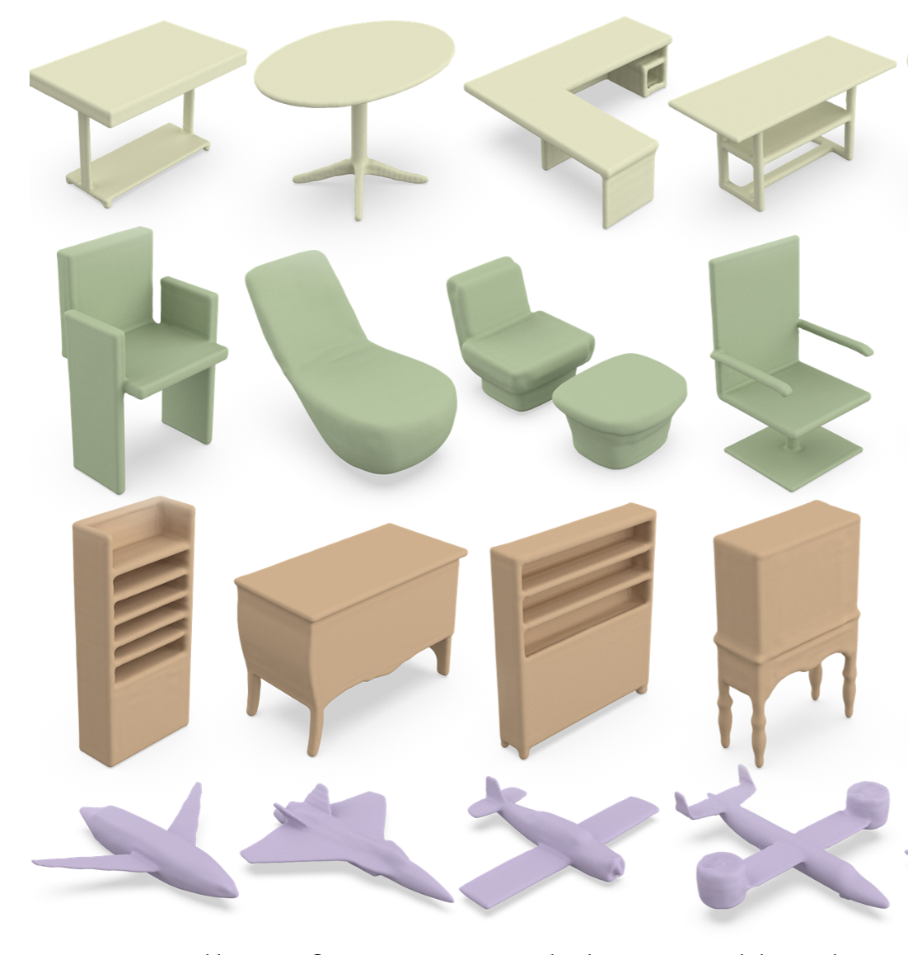
Some Noteworthy Examples of Unconditional Shape Synthesis
IM-Net
Wavelet-domain Diffusion
MeshGPT

Slide 32
Examples of Conditional Shape Synthesis
Low entropy
Points → Surface
ConvONets
High entropy
DeepMLS

Slide 33
Examples of Conditional Shape Synthesis
Low entropy
Points → Surface
Image(s) → Shape
Pix3D
High entropy
One-2-3-45

Slide 34
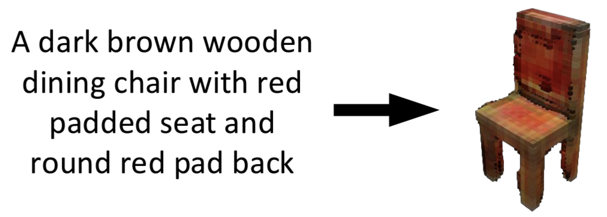
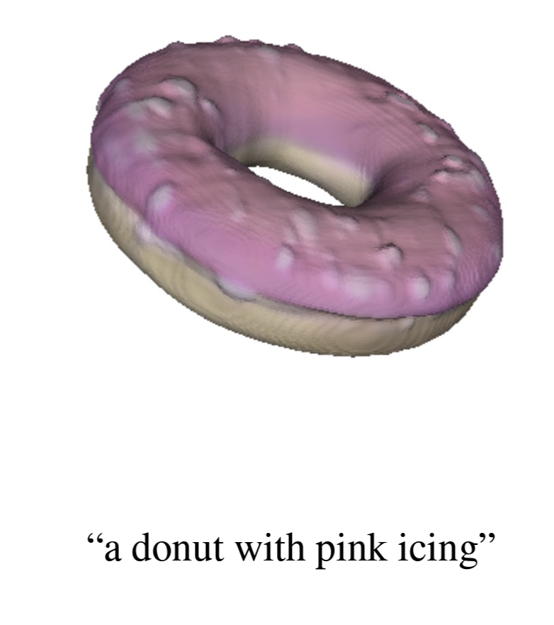
Examples of Conditional Shape Synthesis
Low entropy
Points → Surface
Image(s) → Shape
Text → Shape
Text2Shape
High entropy
Shap-E

Slide 35
A Taxonomy of Prediction Problems
Analysis
Synthesis
Global
Local
Unconditional
Conditional

Slide 36
A Taxonomy of Prediction Problems
Analysis
Synthesis
Global
Local
Unconditional
Conditional

Slide 37
A deep learning problem is characterized by:
What type of prediction problem are we trying to solve?
i.e. what function should ${\tilde{f}}_{θ}\left(x\right)$ compute?
How are we representing the data?
i.e. what form do $x$and $y$ take?
What neural network architecture are we using?
i.e. what parametric family ${\tilde{f}}_{θ}$ are we using?
How will we train the network?
i.e. what optimization algorithm do we use to solve ${argmin}_{θ}\sum_{\left(x,y\right)∈𝒟}{\left|{\tilde{f}}_{θ}\left(x\right)−y\right|}$

Slide 38
A deep learning problem is characterized by:
What type of prediction problem are we trying to solve?
i.e. what function should ${\tilde{f}}_{θ}\left(x\right)$ compute?
How are we representing the data?
i.e. what form do $x$and $y$ take?
What neural network architecture are we using?
i.e. what parametric family ${\tilde{f}}_{θ}$ are we using?
How will we train the network?
i.e. what optimization algorithm do we use to solve ${argmin}_{θ}\sum_{\left(x,y\right)∈𝒟}{\left|{\tilde{f}}_{θ}\left(x\right)−y\right|}$

Slide 39
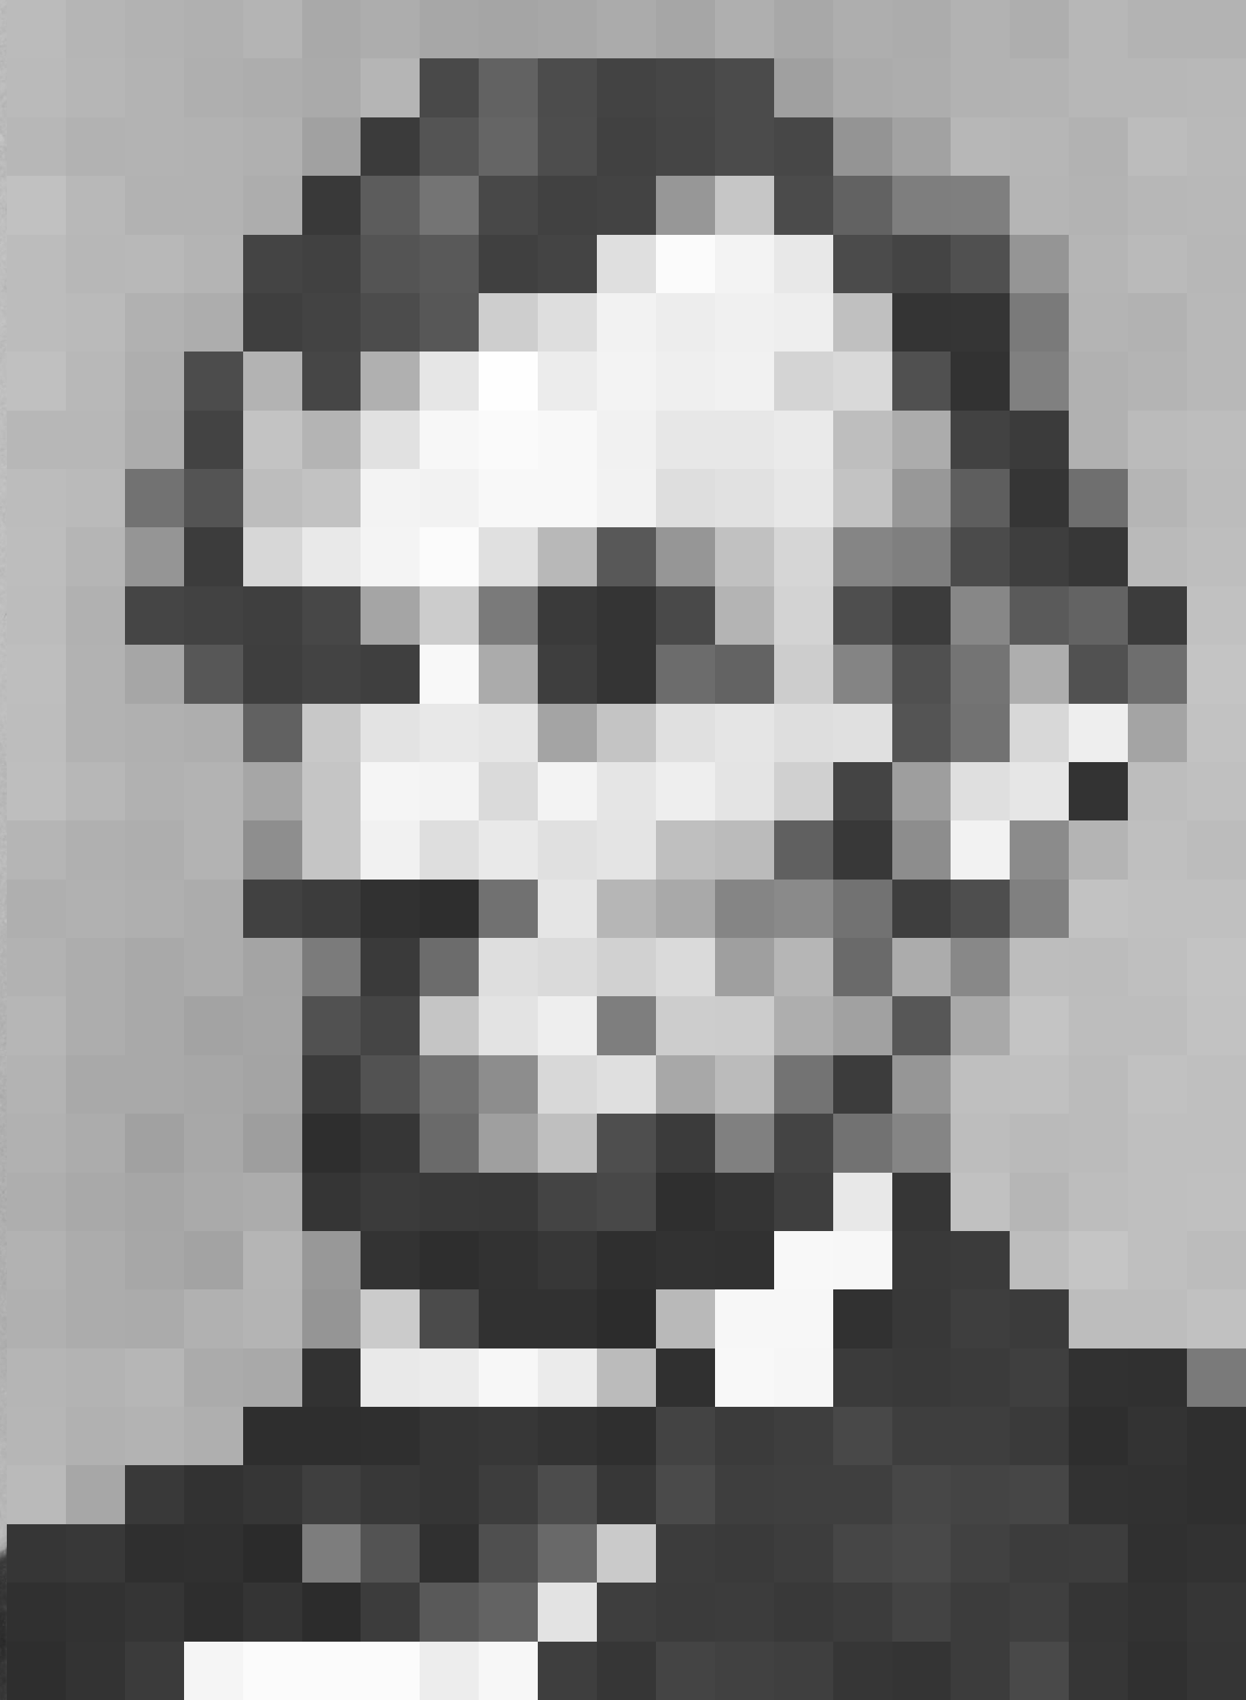
In Other Fields, One Clear Answer
Language Processing
Image Processing
Source
Sequence of Tokens
Source
Grid of Pixels

Slide 40
But: many ways to represent geometry!

Slide 41
REPRESENTATION

Slide 42
There exist good reasons to use different geometry representations for learning
Point Clouds
Easy to acquire from (depth) sensors
Good for AI agents making decisions based on sensor observations
Use learning-based synthesis to convert point clouds to other representations

Slide 43
There exist good reasons to use different geometry representations for learning
Point Clouds
Meshes
Most common representation in graphics! (Lots of available data)
Explicitly represents surface; good for intrinsic analysis tasks

Slide 44
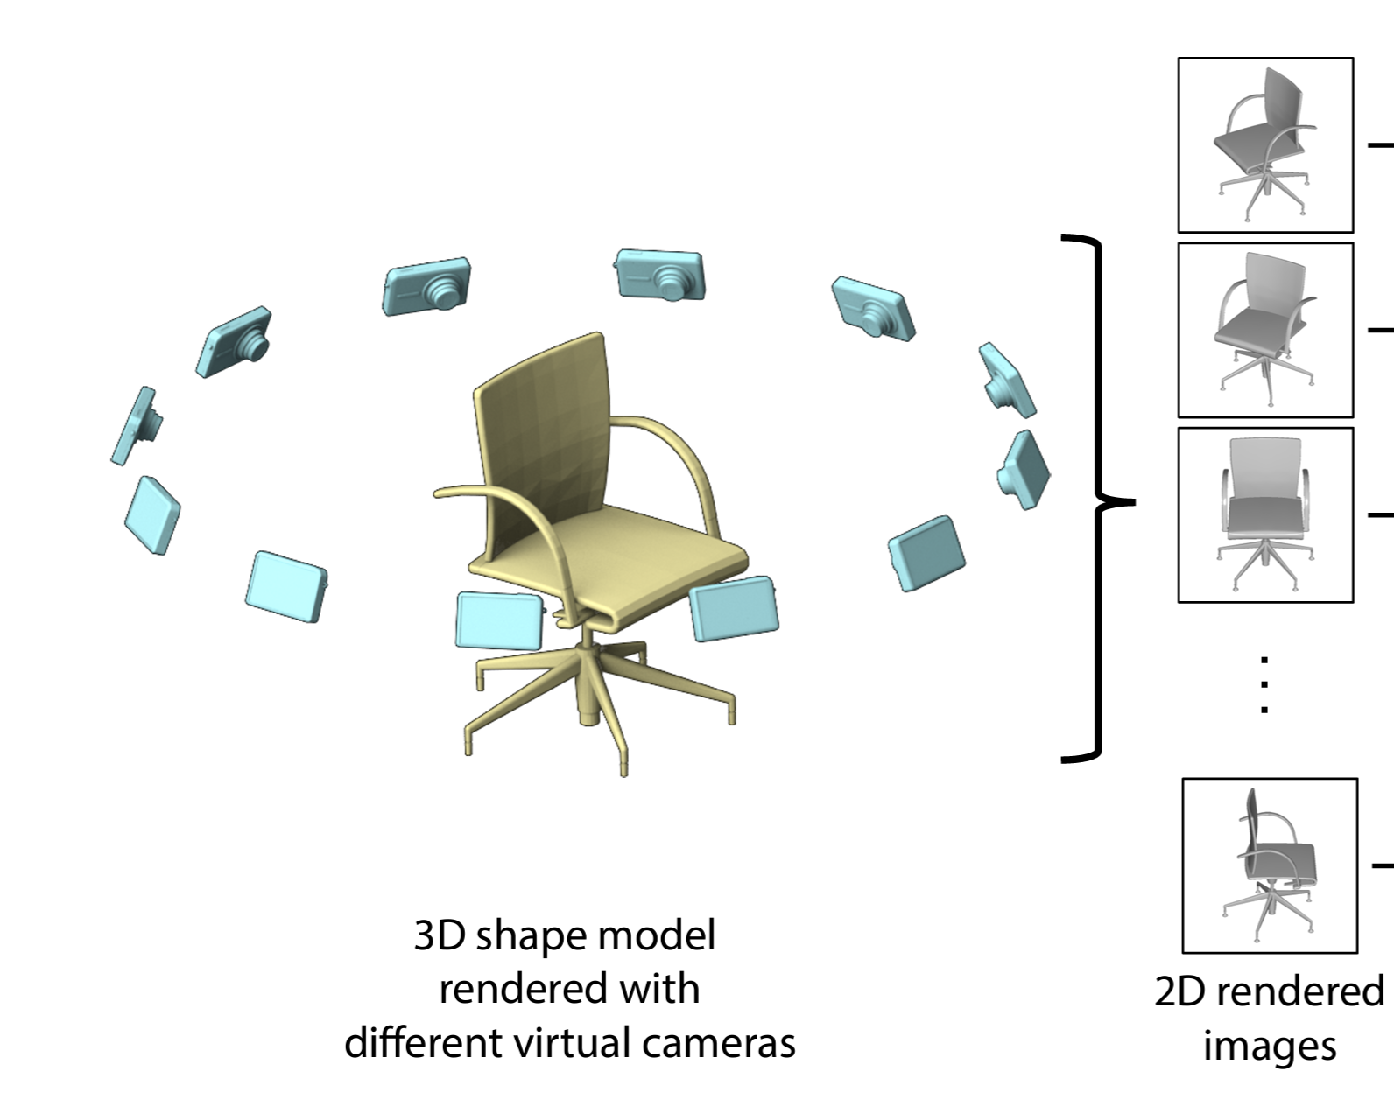
There exist good reasons to use different geometry representations for learning
Point Clouds
Meshes
Images (Views)
Source
Can exploit well-developed methods from 2D image processing / vision

Slide 45
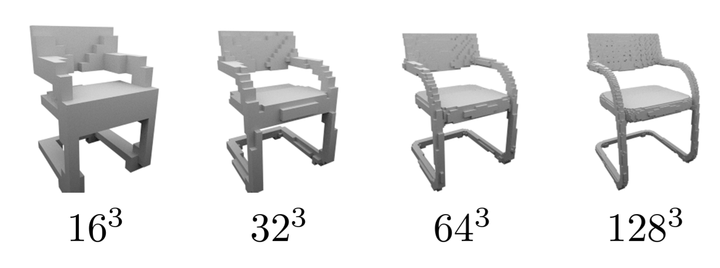
There exist good reasons to use different geometry representations for learning
Point Clouds
Meshes
Images (Views)
3D Grids
Source
Can straightforwardly extend methods from image processing / vision for learning on 2D grids

Slide 46
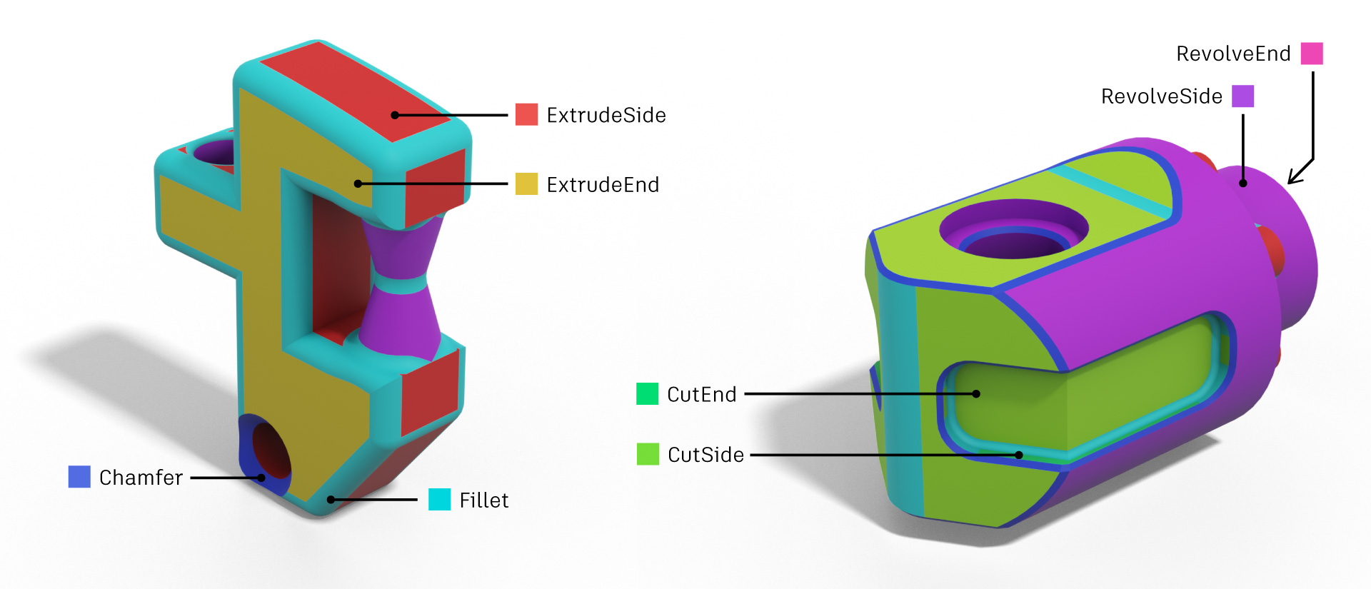
There exist good reasons to use different geometry representations for learning
Point Clouds
Meshes
Images (Views)
3D Grids
CAD Reps
Source
Infinite-resolution representation of a surface
Natural choice for using learning within CAD-based modeling tools

Slide 47
A deep learning problem is characterized by:
What type of prediction problem are we trying to solve?
i.e. what function should ${\tilde{f}}_{θ}\left(x\right)$ compute?
How are we representing the data?
i.e. what form do $x$and $y$ take?
What neural network architecture are we using?
i.e. what parametric family ${\tilde{f}}_{θ}$ are we using?
How will we train the network?
i.e. what optimization algorithm do we use to solve ${argmin}_{θ}\sum_{\left(x,y\right)∈𝒟}{\left|{\tilde{f}}_{θ}\left(x\right)−y\right|}$

Slide 48
A deep learning problem is characterized by:
What type of prediction problem are we trying to solve?
i.e. what function should ${\tilde{f}}_{θ}\left(x\right)$ compute?
How are we representing the data?
i.e. what form do $x$and $y$ take?
What neural network architecture are we using?
i.e. what parametric family ${\tilde{f}}_{θ}$ are we using?
How will we train the network?
i.e. what optimization algorithm do we use to solve ${argmin}_{θ}\sum_{\left(x,y\right)∈𝒟}{\left|{\tilde{f}}_{θ}\left(x\right)−y\right|}$

Slide 49
A Deep Neural Network is:
a composition of functions (or layers) $f\left(x\right)=g\left(h\left(j\left(x\right)\right)\right)$
...some of which have parameters (or weights) $f_{θ}\left(x\right)=g_{θ_{1}}\left(h\left(j_{θ_{2}}\left(x\right)\right)\right), θ=\left\{θ_{1},θ_{2}\right\}$

Slide 50
A Deep Neural Network is:
a composition of functions (or layers) $f\left(x\right)=g\left(h\left(j\left(x\right)\right)\right)$
...some of which have parameters (or weights) $f_{θ}\left(x\right)=g_{θ_{1}}\left(h\left(j_{θ_{2}}\left(x\right)\right)\right), θ=\left\{θ_{1},θ_{2}\right\}$ The functions which have parameters are often called learnable layers

Slide 51
A Deep Neural Network is:
a composition of functions (or layers) $f\left(x\right)=g\left(h\left(j\left(x\right)\right)\right)$
...some of which have parameters (or weights) $f_{θ}\left(x\right)=g_{θ_{1}}\left(h\left(j_{θ_{2}}\left(x\right)\right)\right), θ=\{θ_{1},θ_{2}\}$
...the gradients w.r.t. which are well-defined ${∇_{θ}f}_{θ}\left(x\right)={∇_{\{θ_{1},θ_{2}\}}g}_{θ_{1}}\left(h\left(j_{θ_{2}}\left(x\right)\right)\right)$

Slide 52
The Three Primary Types of Learnable Layers
Fully-connected (a.k.a. linear* layers)
$$y=Wx+b$$
“Fully-connected”: every element of the output $y_{i}$ is linearly related to every element of the input $x_{i}$
When multiple of these are composed with a (parameter-less) nonlinear function between each, that’s called a multilayer perception (or MLP)
*These really should be called affine layers

Slide 53
The Three Primary Types of Learnable Layers
Fully-connected (a.k.a. linear* layers)
(Something like) Convolution
Each element of the output $y_{i}$ is a function of the local neighborhood $𝒩$ of the corresponding element of the input $x_{i}$
Often (but not always), this function is a weighted combination of local neighborhood
See Message Passing Neural Networks for an exception
$$x_{2}$$
$$y=Wx+b$$
$$x_{1}$$
$$x_{3}$$
$$x_{0}$$
$$x_{i}$$
$$x_{4}$$
$$x_{5}$$
$$x_{7}$$
$$x_{6}$$
$$x_{8}$$
$$x_{8}$$
$$y_{i}=\sum_{x_{j}∈𝒩\left(x_{i}\right)}{f_{θ}\left(x_{i}, x_{j}\right)}$$
often $w_{θ}\left(x_{i}, x_{j}\right)x_{j}$

Slide 54
The Three Primary Types of Learnable Layers
Fully-connected (a.k.a. linear* layers)
(Something like) Convolution
Attention (Transformers)
$$x_{2}$$
$$y_{i}=\sum_{x_{j}∈x}{\left(Qx_{i}⋅Kx_{j}\right)Vx_{j}}$$
$$y=Wx+b$$
$$x_{1}$$
$$x_{3}$$
$$x_{0}$$
$$x_{i}$$
$$x_{4}$$
$$x_{5}$$
$$x_{7}$$
$$x_{6}$$
$$x_{8}$$
Each element of the input $x_{i}$ is linearly transformed into a query vector $Qx_{i}$, key vector $Kx_{i}$, and value vector $Vx_{i}$
Each element of the output $y_{i}$ is a weighted combination of all the value vectors w/ weight $Qx_{i}⋅Kx_{j}$
$$x_{8}$$
$$y_{i}=\sum_{x_{j}∈𝒩\left(x_{i}\right)}{f_{θ}\left(x_{i}, x_{j}\right)}$$

Slide 55
The Three Primary Types of Learnable Layers
Fully-connected (a.k.a. linear* layers)
(Something like) Convolution
Attention (Transformers)
$$x_{2}$$
$$y_{i}=\sum_{x_{j}∈x}{\left(Qx_{i}⋅Kx_{j}\right)Vx_{j}}$$
$$y=Wx+b$$
$$x_{1}$$
$$x_{3}$$
$$x_{0}$$
$$x_{i}$$
$$x_{4}$$
$$x_{5}$$
$$x_{7}$$
$$x_{6}$$
$$x_{8}$$
Intuitively: the weights represent how much “attention” each element pays to each other element (based on their distance in a learned feature space)
I am eliding details here; see The Illustrated Transformer for an exhaustive tutorial
$$x_{8}$$
$$y_{i}=\sum_{x_{j}∈𝒩\left(x_{i}\right)}{f_{θ}\left(x_{i}, x_{j}\right)}$$

Slide 56
Geometry representation and network architecture are tightly coupled
Images (Views)
Can exploit well-developed methods from 2D image processing / vision
Examples:
Shape classification
Shape segmentation
Shape reconstruction from sketches

Slide 57
Geometry representation and network architecture are tightly coupled
Images (Views)
3D Grids
Can straightforwardly extend methods from image processing / vision for learning on 2D grids
Of note: architectures for adaptive grids (e.g. octrees)
For 3D shape analysis
For 3D shape generation

Slide 58
Geometry representation and network architecture are tightly coupled
Images (Views)
3D Grids
CAD Reps
Networks for analyzing boundary representations (B-Reps): SB-GCN, BRepNet, ...
Networks for synthesizing CAD modeling sequences (programs): DeepCAD, SkexGen, ...

Slide 59
Geometry representation and network architecture are tightly coupled
Images (Views)
3D Grids
CAD Reps
Point Clouds
Meshes
Where the most (and most influential) architectural innovation has been happening
Let’s look in a bit more detail at an example of each

Slide 60
A Point Cloud Architecture: PointNet
Source

Slide 61
A Point Cloud Architecture: PointNet
Ignore this for now
Each point independently processed by an MLP
Source

Slide 62
A Point Cloud Architecture: PointNet
Ignore these for now
Each point independently processed by another MLP (deep = more layers)
Source

Slide 63
A Point Cloud Architecture: PointNet
Compute global descriptor of the whole point cloud by element-wise maximum across the feature vectors for all points
Source

Slide 64
A Point Cloud Architecture: PointNet
One more MLP to map this global feature into (log) probabilities for each class
Source

Slide 65
A Point Cloud Architecture: PointNet
Key idea: Individually (locally) process each point into a higher-dimensional feature space, then combine per-point features via an order-invariant function (e.g. max) to produce a global feature descriptor
Order invariance is key, as points in a point cloud are not ordered
Source

Slide 66
A Point Cloud Architecture: PointNet
(Optionally) transform input points and intermediate vectors by a predicted matrix
T-Net is just a smaller PointNet (without the “___ transform” blocks)
Intuition: learned, input-dependent transform may help ‘canonicalize’ the data
Empirically leads to slightly better performance
Source

Slide 67
A Point Cloud Architecture: PointNet
Can be used for segmentation (or other local analysis tasks) with a slight tweak
Concat global feature to each point feature → independent processing
Intuition: global feature makes point processing “context-aware”
Source

Slide 68
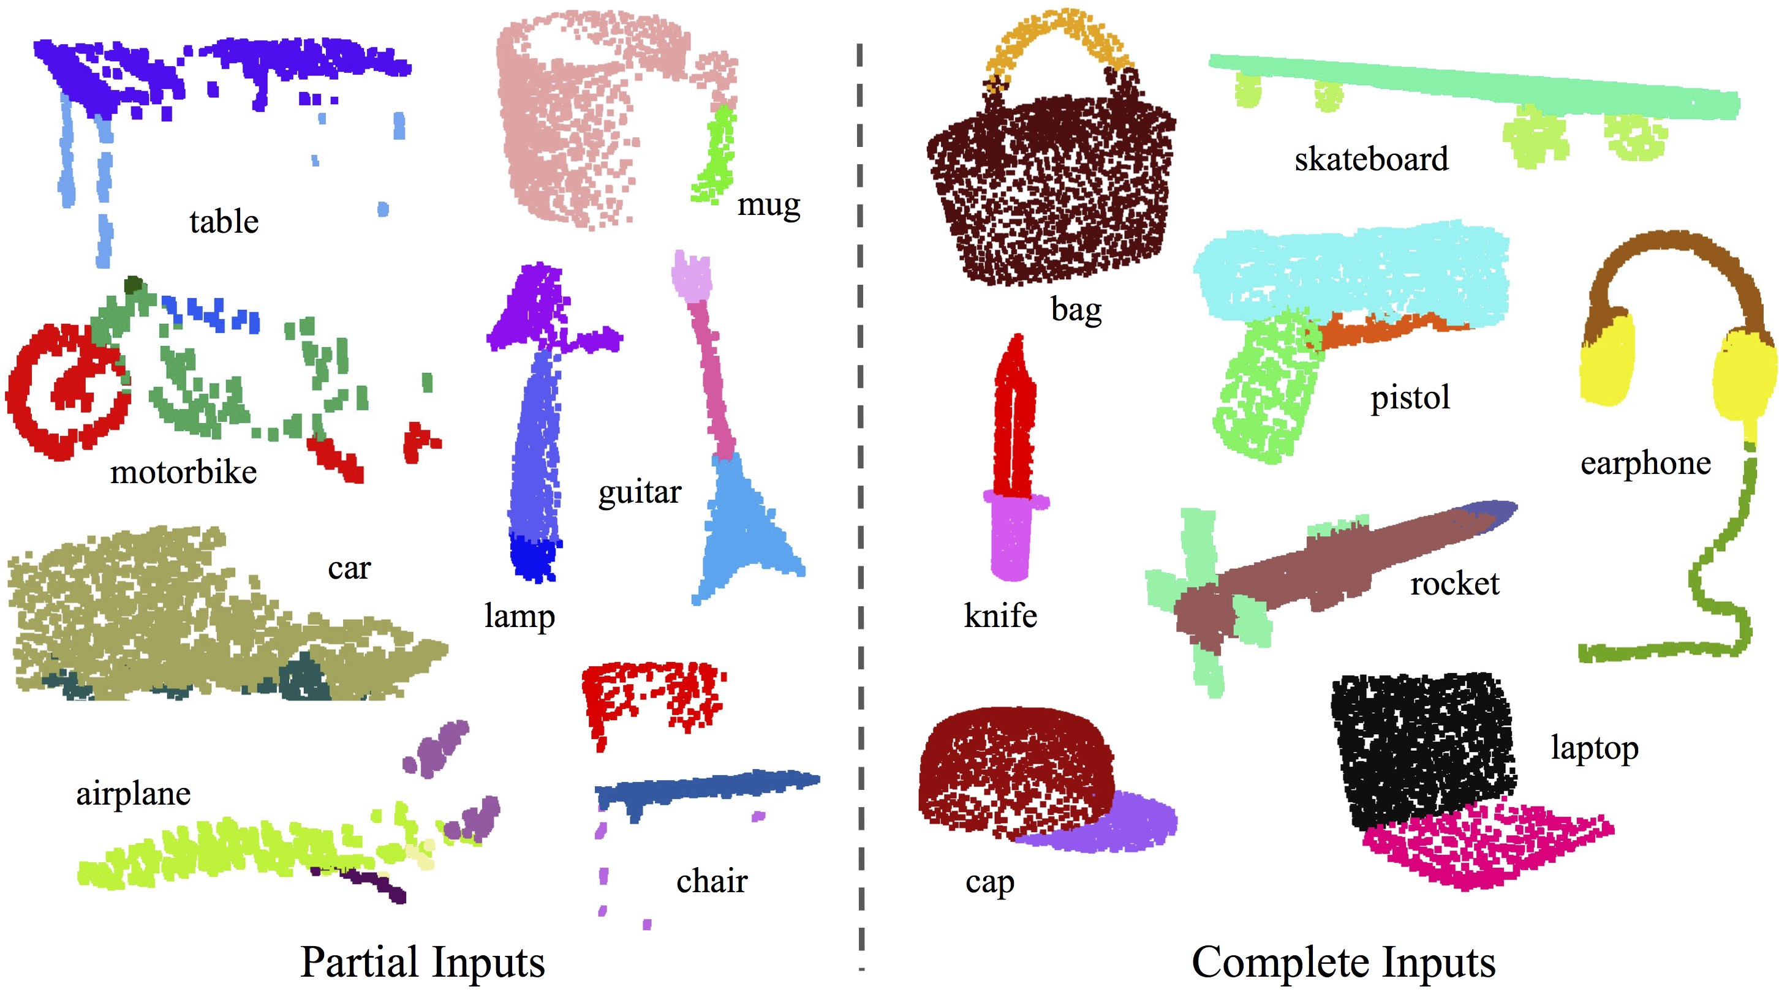
PointNet can segment 3D object point clouds

Slide 69
More Noteworthy Point Cloud Networks
Dynamic Graph CNN (DGCNN)
Point cloud processing using convolution-like learnable layers
Point Transformer
Point cloud processing using attention-based learnable layers

Slide 70
A Mesh Architecture: MeshCNN
Key idea: define a convolution operator on mesh edges
In manifold mesh (without boundaries), every edge $e$ has four neighbor edges $a$, $b$, $c$, and $d$.
Ordering of $a$, $b$ and $c$, $d$ given by the winding order of the triangles (i.e. CCW about the normal direction)
Source

Slide 71
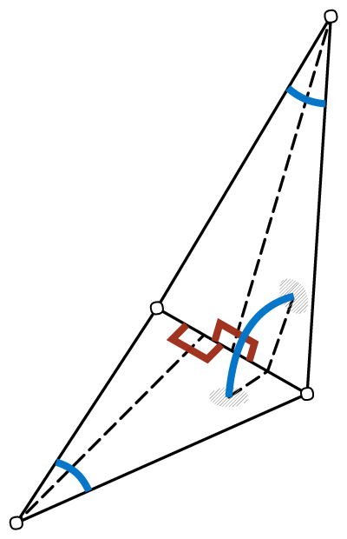
A Mesh Architecture: MeshCNN
Key idea: define a convolution operator on mesh edges
As input, each edge $i$ stores a 5-dimensional feature vector $f_{i}$:
The dihedral angle
Source

Slide 72
A Mesh Architecture: MeshCNN
Key idea: define a convolution operator on mesh edges
As input, each edge $i$ stores a 5-dimensional feature vector $f_{i}$:
The dihedral angle
The two interior angles
Source

Slide 73
A Mesh Architecture: MeshCNN
Key idea: define a convolution operator on mesh edges
As input, each edge $i$ stores a 5-dimensional feature vector $f_{i}$:
The dihedral angle
The two interior angles
The ratio of the edge length to the perpendicular length for each adjacent face
Source

Slide 74
A Mesh Architecture: MeshCNN
Key idea: define a convolution operator on mesh edges
The convolution operator is then defined as:
$$w_{o}f_{e}+\sum_{i=1}^{4}{w_{i}{\hat{f}}_{i}}$$
where
$$\left({\hat{f}}_{1},{\hat{f}}_{2},{\hat{f}}_{3},{\hat{f}}_{4}\right)=\left(\left|f_{a}−f_{c}\right|,f_{a}+f_{c}, \left|f_{b}−f_{d}\right|,f_{b}+f_{d}\right)$$
Why?
Doesn’t matter how the two incident faces are ordered (order-invariant functions again!)
Source

Slide 75
A Mesh Architecture: MeshCNN
Key idea: define a convolution operator on mesh edges
As PointNet aggregate local features into global features, MeshCNN also aggregates local features into increasingly global features by edge-collapse-based pooling
Source

Slide 76
A Mesh Architecture: MeshCNN
Key idea: define a convolution operator on mesh edges
As PointNet aggregate local features into global features, MeshCNN also aggregates local features into increasingly global features by edge-collapse-based pooling
Can also (sort of) ‘undo’ pooling by reversing the sequence of edge collapses
Source

Slide 77
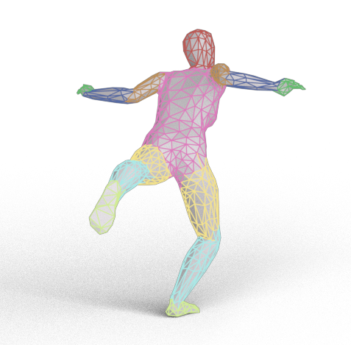
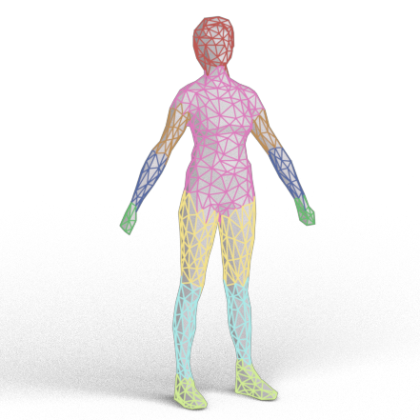
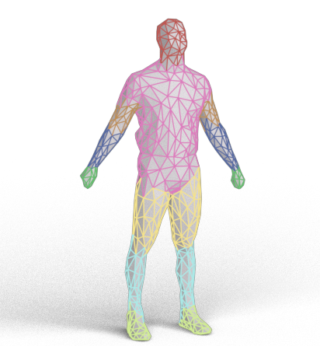
MeshCNN can segment human body meshes

Slide 78
More Noteworthy Mesh Architectures
DiffusionNet
Uses continuous diffusion (i.e. solution to the heat equation) rather than discrete convolution
Is ‘discretization-agnostic’: generalizes to arbitrarily tessellated meshes
MeshGPT
Transformer-model for directly generating meshes (as a sequence of vertices and faces
Core architecture could also be applied to analysis tasks

Slide 79
A deep learning problem is characterized by:
What type of prediction problem are we trying to solve?
i.e. what function should ${\tilde{f}}_{θ}\left(x\right)$ compute?
How are we representing the data?
i.e. what form do $x$and $y$ take?
What neural network architecture are we using?
i.e. what parametric family ${\tilde{f}}_{θ}$ are we using?
How will we train the network?
i.e. what optimization algorithm do we use to solve ${argmin}_{θ}\sum_{\left(x,y\right)∈𝒟}{\left|{\tilde{f}}_{θ}\left(x\right)−y\right|}$

Slide 80
A deep learning problem is characterized by:
What type of prediction problem are we trying to solve?
i.e. what function should ${\tilde{f}}_{θ}\left(x\right)$ compute?
How are we representing the data?
i.e. what form do $x$and $y$ take?
What neural network architecture are we using?
i.e. what parametric family ${\tilde{f}}_{θ}$ are we using?
How will we train the network?
i.e. what optimization algorithm do we use to solve ${argmin}_{θ}\sum_{\left(x,y\right)∈𝒟}{\left|{\tilde{f}}_{θ}\left(x\right)−y\right|}$

Slide 81
Using neural networks to solve prediction problems involving 3D geometry (Daniel, ~40 mins)
Using neural networks as a representation of 3D geometry (Zoë, ~40 mins)
5 minute break

Slide 82
Using neural networks to solve prediction problems involving 3D geometry (Daniel, ~40 mins)
Using neural networks as a representation of 3D geometry (Zoë, ~40 mins)
5 minute break

